Slide 1
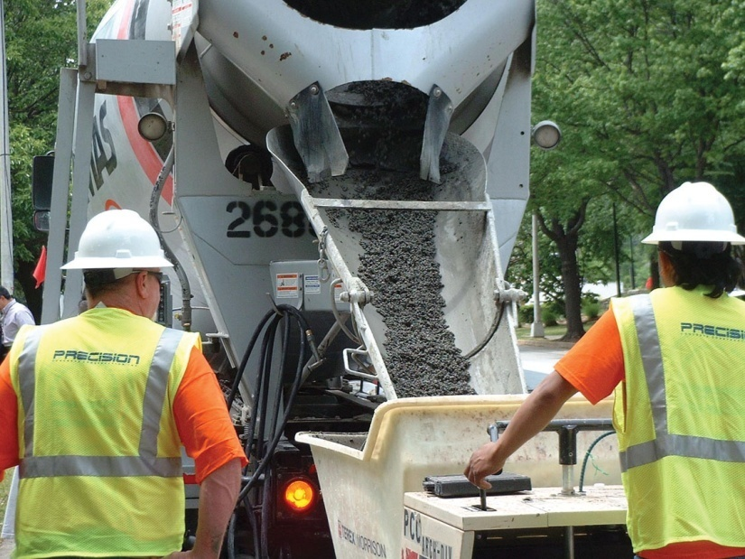
FIGURE 29.1 Pervious (No-Fines) Concrete Being Discharged From a Truck-Mixer
Copyright © 2016 Elsevier Ltd. All rights reserved.

Slide 2
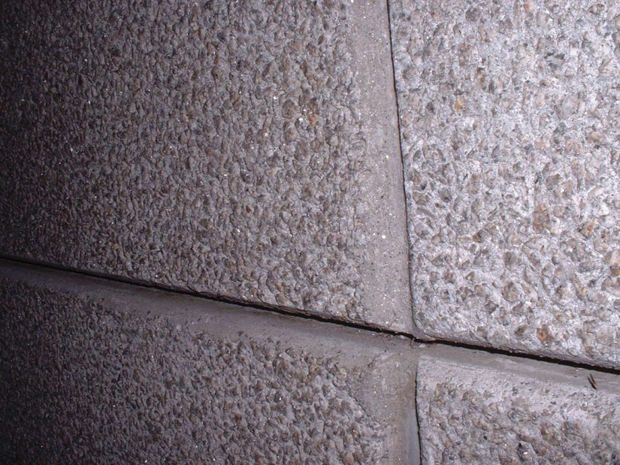
FIGURE 29.2 Exposed Aggregate Concrete
Copyright © 2016 Elsevier Ltd. All rights reserved.

Slide 3
FIGURE 29.3 Ribbed Concrete
Copyright © 2016 Elsevier Ltd. All rights reserved.

